Slide 1
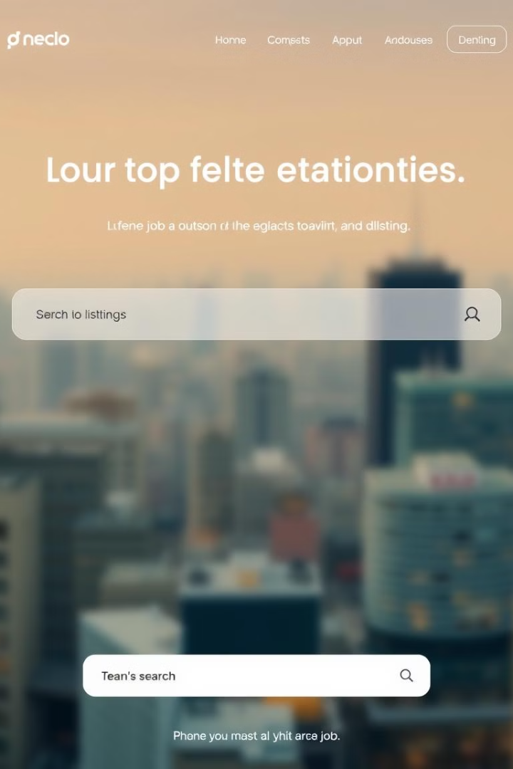
Job Portal App: MERN Stack for Decent Work
A comprehensive job portal app built using the MERN stack.
SK
by Shivam Kumar

Slide 2
MERN Stack Overview: MongoDB, Express, React, Node
MongoDB: A NoSQL database for storing job listings, user profiles, and application data.
Express: A Node.js web framework for building the backend API to handle requests from the frontend.
React: A JavaScript library for building the user interface, providing a dynamic and interactive experience for job seekers and employers.
Node.js: A JavaScript runtime environment that powers the backend server and enables efficient handling of network requests.

Slide 3

Secure User Authentication with JWT
1
JWT (JSON Web Tokens) provides a secure and efficient way to authenticate users.
2
Users can create an account and login to access job listings and manage applications.
3
Tokens are used to verify user identities and prevent unauthorized access.

Slide 4
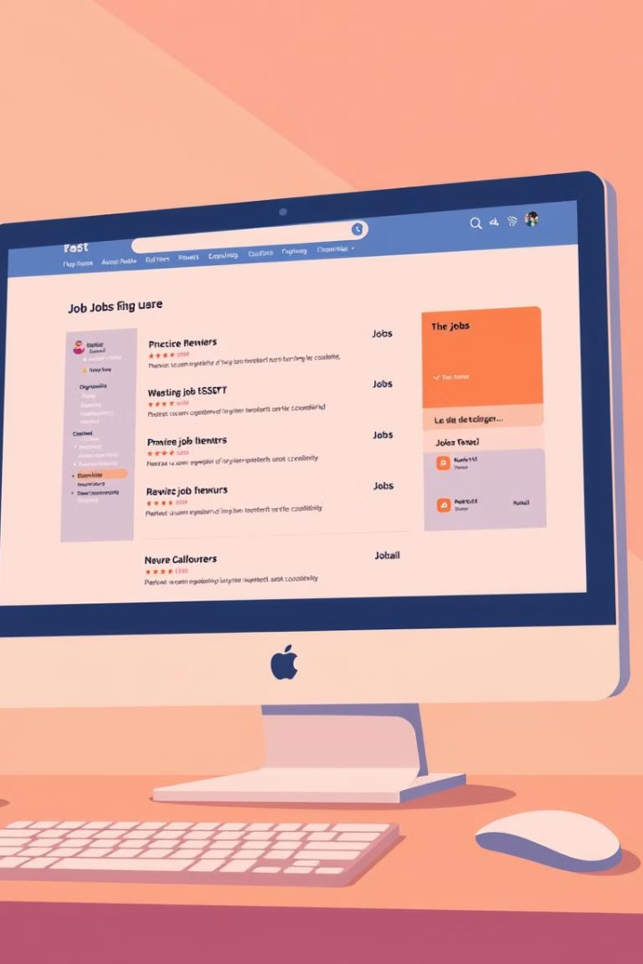
Job Listings & Search Functionality in MongoDB
Job seekers can browse through a wide range of job listings.
MongoDB's powerful query language allows for efficient searching by keywords, location, industry, and other criteria.
The job listings are categorized based on industry, location, and other relevant factors.
Employers can post their job openings with detailed descriptions and requirements.

Slide 5




Application Management System: Job Seeker View
Job seekers can apply for jobs by uploading their resume and cover letter.
They can track their applications, view the status of each application, and manage their job search activity.
Job seekers receive notifications regarding new jobs and application updates.

Slide 6
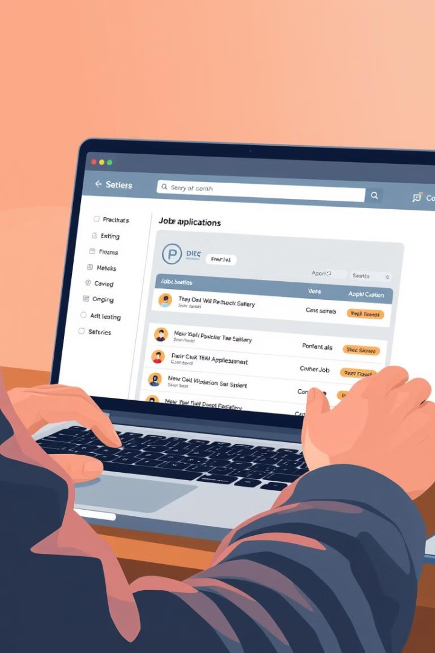
Application Management System: Employer View
1
Employers can review applications submitted by job seekers.
2
They can filter and sort applications based on specific criteria.
3
They can contact shortlisted candidates for interviews and further assessment.

Slide 7
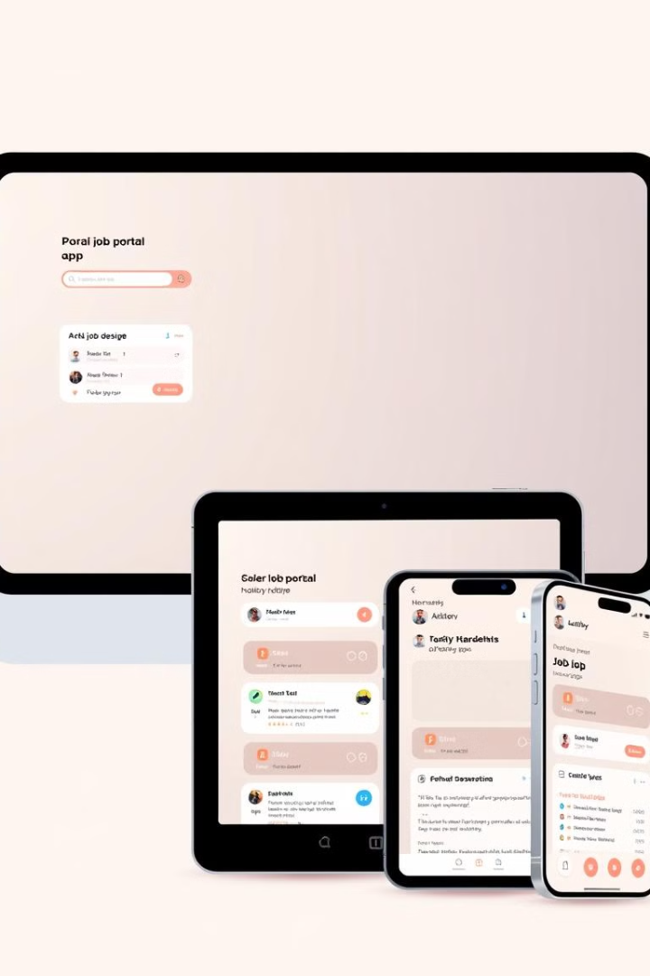
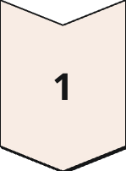
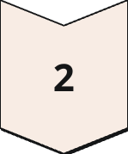
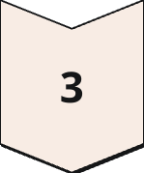
Responsive Design for All Devices
The app is designed to be responsive and accessible on all devices, including desktops, tablets, and mobile phones.
The user interface adjusts seamlessly to different screen sizes and resolutions.
This ensures a consistent and enjoyable experience for all users.

Slide 8
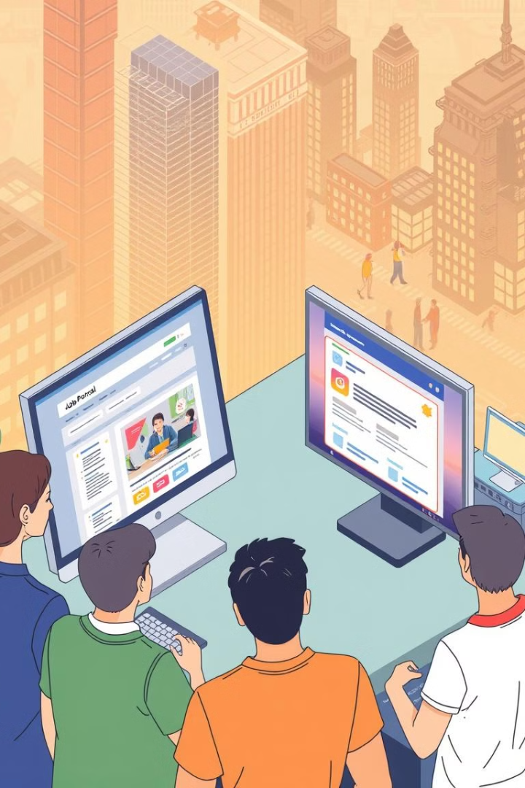
Contributing to SDG 8: Decent Work & Economic Growth
The app aims to facilitate job matching and connect job seekers with suitable opportunities.
By streamlining the job search process, it promotes economic growth and decent work.
It provides a platform for individuals to find employment and contribute to the workforce.

